Slide 1
Feature Review
August 2025
Rami Ibrahimi

Slide 2
Current State: Manual Chaos → Intelligent Automation
PAIN POINTS 📊 15% Stockout Rate Lost sales & customer satisfaction 💰 $8M Excess Inventory Tied-up working capital ⏱️ 4+ Hours Weekly Manual Excel planning 🔄 Reactive Ordering No demand visibility | SOLUTION 🎯 AI-Powered Planning Real-time recommendations 🔍 Exception Management Focus on what matters 🌐 Multi-Location Optimization Unified global view 📈 Predictive Intelligence ML-driven forecasts & Periodic review system
TARGET USER: Supply Chain Analysts & Inventory Managers
BUSINESS IMPACT: 50% ↓ Stockouts | 20% ↓ Inventory | 80% ↓ Time

Slide 3
Key Concepts
Core Components
🧠 Intelligent Forecast Engine ML ensemble: Prophet, LightGBM, N-HiTS Dynamic model weighting External signals integration | 🌍 Multi-Echelon Optimization Unified planning: US, UK, Germany Currency-aware calculations Network transfer opportunities | ⚡ Exception-Driven Workflow Proactive alerts for issues Prioritized action queue One-click resolution | 💬 Conversational AI Assistant Natural language queries Transparent calculations In-context actions
Guiding Principles
🤖 Automation First Minimize manual intervention | 👁️ Transparency Show calculation logic
🎛️ Flexibility Support planner overrides | 📈 Scalability Handle 1000+ SKUs efficiently

Slide 4
Business Scenario: Premium Laptop Stand
💻 SKU: PLS-001 | Lead Time: 21 days | MOQ: 500
📦 Inventory | 📊 Weekly Demand | ⏱️ Days
US: 850 🟡 | US: 180 (σ=35) | 4.7 ⚠️
UK: 120 🔴 | UK: 45 (σ=12) | 2.7 🚨
DE: 75 🔴 | DE: 30 (σ=8) | 2.5 🚨
Transit: 500 | Total: 255/week | —
📐 Safety Stock Formula
𝑆𝑆 = 𝑧 × 𝜎 × √(𝑃+𝐿)
Where: z = 1.65 (95% service level)
σ = demand std deviation
P = review period (1 week)
L = lead time (3 weeks)

Slide 5
Business Scenario: Premium Laptop Stand-cont.
💻 SKU: PLS-001 | Lead Time: 21 days | MOQ: 500
🎯 RECOMMENDED ACTIONS
✅ US: Order 1,000 units • Prevents stockout in 15 days • Order value: $25,00 | ✅ UK: Transfer 200 units from US • Immediate availability • Utilizes US excess capacity | ✅ DE: No action required • Coverage sufficient after UK transfer
📊 CALCULATION DETAILS
US Safety Stock = 1.65 × 35 × √4 = 115 units Target Level = (180 × 4) + 115 = 835 units Current Position = 850 + 500 = 1,350 units Days to Reorder = (1,350-835)/25.7 = 20 days
- Prevented Revenue Loss: $45,000
- Working Capital Saved: $20,000
- Weekly Time Saved: 2 hours
- ROI: 180% immediate return

Slide 6
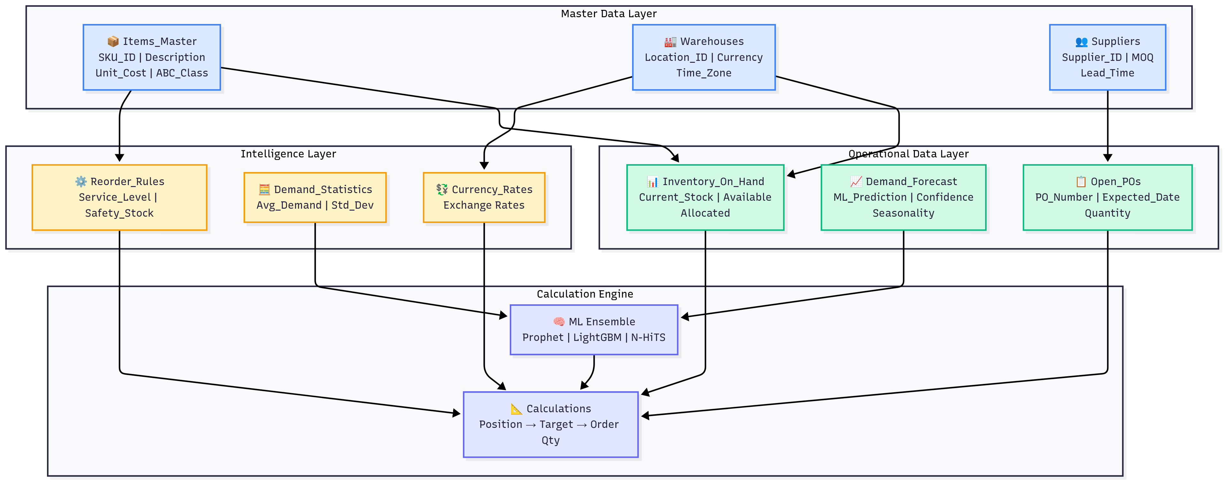
Data Model Architecture
Data Model Architecture
🔄 Data Flow: Real-time inventory → ML forecasts → Smart recommendations

Slide 7
Implementation Approach & Timeline
━━━━━━━━━━━━━━━━━━━━━━━━━━ Week 1-4 Week 5-8 Week 9-12
FOUNDATION → INTELLIGENCE → OPTIMIZATION
━━━━━━━━━━━━━━━━━━━━━━━━━━
🏗️ FOUNDATION | 🧠 INTELLIGENCE | 🚀 OPTIMIZATION
Activities: Deploy calculation engine Connect data sources Basic dashboard launch Train core users Deliverables: ✓ Automated calculations ✓ Real-time inventory view ✓ Manual override capability Outcome: ⏱️ 3 hours/week saved | Activities: Activate ML forecasting Enable exception detection Multi-location optimization Expand user base Deliverables: ✓ AI-powered predictions ✓ Proactive alerts ✓ Network visibility Outcome: 📉 50% stockout reduction | Activities: Launch AI assistant Advanced analytics Mobile deployment Full rollout Deliverables: ✓ Natural language interface ✓ Transfer recommendations ✓ Complete automation Outcome: 💰 Full ROI realization

Slide 8
Implementation Approach & Timeline-cont.
📊 Success Metrics
Metric | Current | Phase 2 | Phase 3
Planning | 4 hrs/wk | 2 hrs/wk | 45 min/wk
Stockouts | 15% | 10% | 7.5%
Inventory | $8M | $7.2M | $6.4M
Accuracy | 70% | 80% | 85%
💡 Low-Risk Approach: Each phase delivers immediate value while building toward full automation

Slide 9
Technical Architecture
📥 INBOUND | ⚙️ PROCESSING | 📤 OUTBOUND
Data Sources: - ERP Systems └─ Item master, costs - WMS Real-time └─ Inventory positions - Sales CRM └─ Pipeline, forecasts - External APIs └─ Weather, trends 🔄 Update Frequency: Real-time & Batch | Core Components: - ML Engine └─ Prophet, LightGBM - Rules Engine └─ Business logic - Optimizer └─ Network balancing - AI Assistant └─ GPT-3.5 powered ⚡ Performance: <100ms response time | Integrations: - PO Generation └─ Direct to procurement - Notifications └─ Email, Slack alerts - BI/Analytics └─ Tableau, PowerBI - Finance Systems └─ Inventory projections ✅ Actions: Automated & tracked
Frontend: React + Embedded Chat
Backend: Python ML + Kafka Streaming
Deploy: Kubernetes + Auto-scaling
💡 Modern, scalable architecture integrates with your existing systems

Slide 10
Business Value & ROI
💵 INVESTMENT One-Time Cost - Development & Implementation $120,000 - Training & Change Management $20,000 - ML Model Training $10,000 Total Investment: $150,000 | 📈 ANNUAL RETURNS Recurring Benefits - Stockout Reduction (50%) $300,000 - Inventory Reduction (20%) $200,000 - Labor Savings (3+ hrs/week) $100,000 Total Annual Benefit: $600,000 | 💰 ROI SUMMARY Payback Period: 3 months 5-Year NPV: $2.1M IRR: 400%
🏆 Competitive Advantage
Planning Speed | Forecast Accuracy | Exception Response | Scalability
80% faster 4hr → 45min | +15-20% improvement | Proactive vs Reactive | 10K+ SKUs supported

Slide 11
Open Questions
1. ML Model Strategy
Should we include external signals (weather, events) from day one,
or phase them in after establishing baseline accuracy?
2. User Experience
How aggressive should auto-approval thresholds be initially?
Start conservative or trust the AI?
3. Rollout Approach
Pilot with one geography or all three simultaneously?
High-value SKUs first or full catalog?
4. Integration Priorities
Which downstream systems need real-time vs batch updates?
Build APIs for third-party tools immediately?
5. Change Management
How long should we run Excel processes in parallel?
What KPIs trigger full automation?

Slide 12
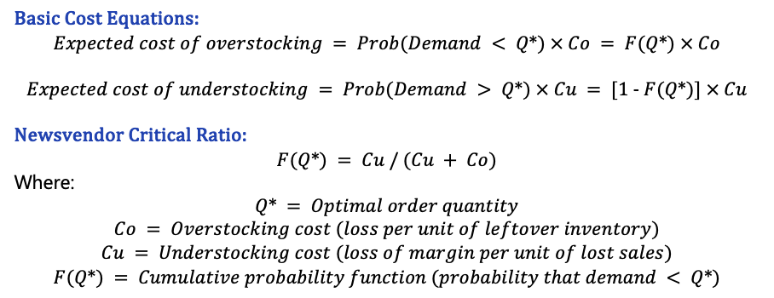
Appendix 1 – News Vendor Model
Basic Cost Equations:
$$Expected cost of overstocking = Prob(Demand < Q*) × Co = F(Q*) × Co$$
$$Expected cost of understocking = Prob(Demand > Q*) × Cu = [1 - F(Q*)] × Cu$$
Newsvendor Critical Ratio:
$$F(Q*) = Cu / (Cu + Co)$$
Where:
$$Q* = Optimal order quantity \\ Co = Overstocking cost (loss per unit of leftover inventory) \\ Cu = Understocking cost (loss of margin per unit of lost sales) \\ F(Q*) = Cumulative probability function (probability that demand < Q*)$$

Slide 13
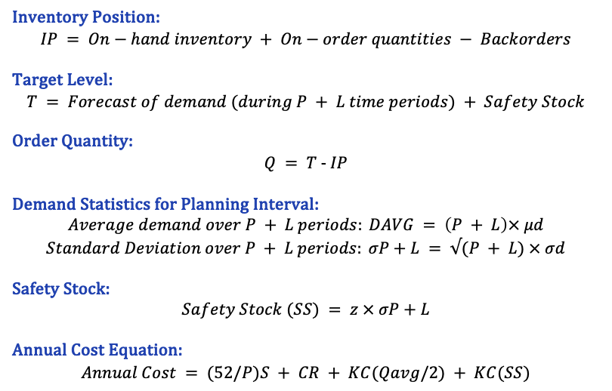
Appendix 2 – Periodic Review System and Safety Stock
Inventory Position:
$$IP = On−hand inventory + On−order quantities − Backorders$$
Target Level:
$$T = Forecast of demand (during P + L time periods) + Safety Stock$$
Order Quantity:
$$Q = T - IP$$
Demand Statistics for Planning Interval:
$$Average demand over P + L periods: DAVG = \left(P + L\right)× μd$$
$$Standard Deviation over P + L periods: σP+L = √(P + L) × σd$$
Safety Stock:
$$Safety Stock (SS) = z × σP+L$$
Annual Cost Equation:
$$Annual Cost = (52/P)S + CR + KC(Qavg/2) + KC(SS)$$
Variable Definitions:
IP = Inventory position
T = Target inventory level
Q = Order quantity
P = Review period (in weeks)
L = Lead time
μd = Mean demand per period
σd = Standard deviation of demand per period
σP+L = Standard deviation over planning interval
z = Service factor constant (based on desired service level)
S = Cost of ordering (fixed)
C = Cost per unit
R = Annual demand
K = Fraction of unit cost for carrying inventory annually
Qavg = Average order size = (R/52) × P
SS = Safety stock

Slide 14
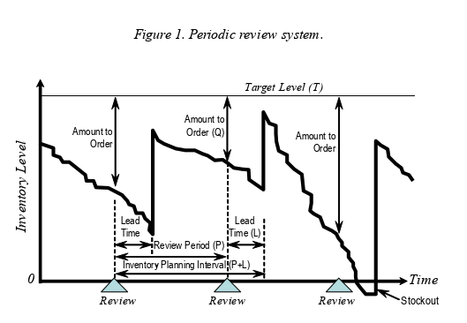
Appendix 2 – Cont.

